Slide 1
Bilong wanem yumi planim strongpela NARI Taro? Yumi lukim piksa bilong wanpela traim long NARI Lae, 2018.

Slide 2
NARI i tok tenkyu long ol European Union lain i bin halivim ol dispela kain wok.

Slide 3
Ol NARI wokmanmeri bin planim long NARI, Lae, 2018→
8 pela kain NARI Taro, na
wanpela lokal Taro – Numkowec

Slide 4
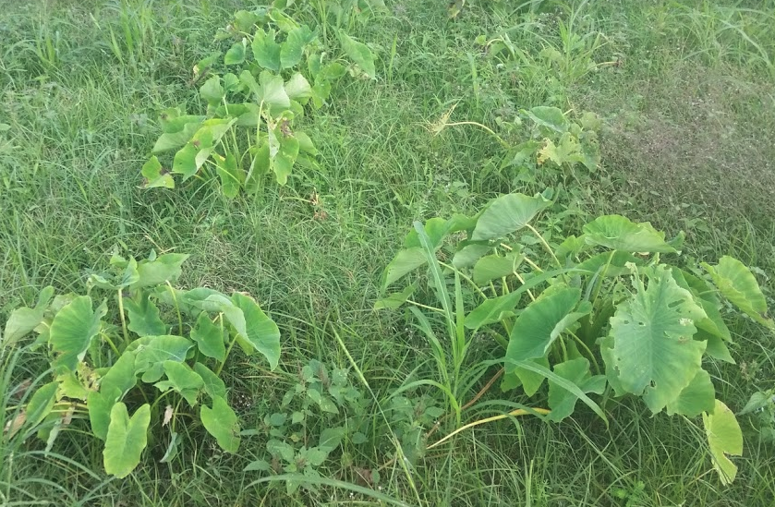
Lokal TARO i no strong long taim bilong lip sik i stap.

Slide 5
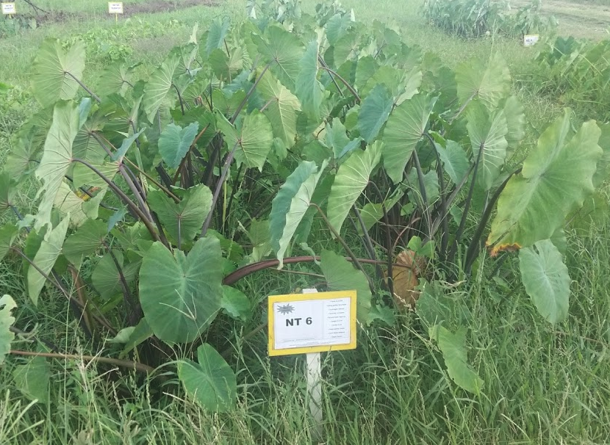
Luk olsem NARI TARO i winim lokal TARO?

Slide 6
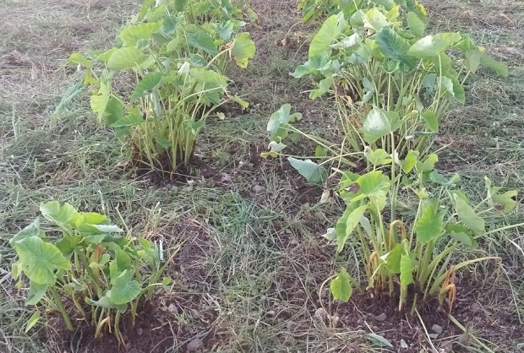
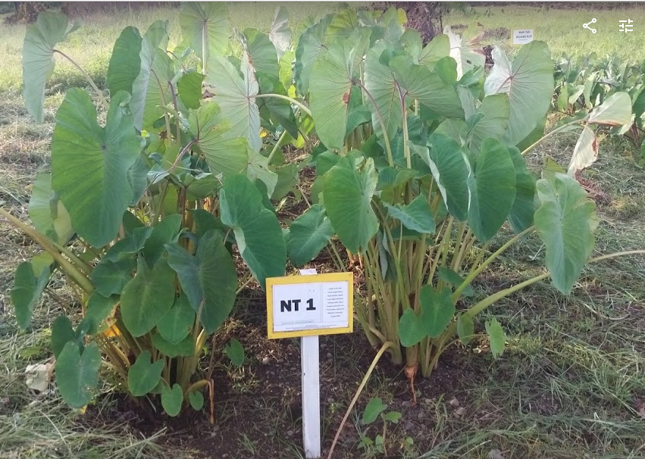
NARI Taro i swit na strong long taim bilong lip sik i stap.
Numkowec, Taro Leaf Blight i bagarapim em
Taro Leaf Blight i no inap bagarapim em – NT1

Slide 7
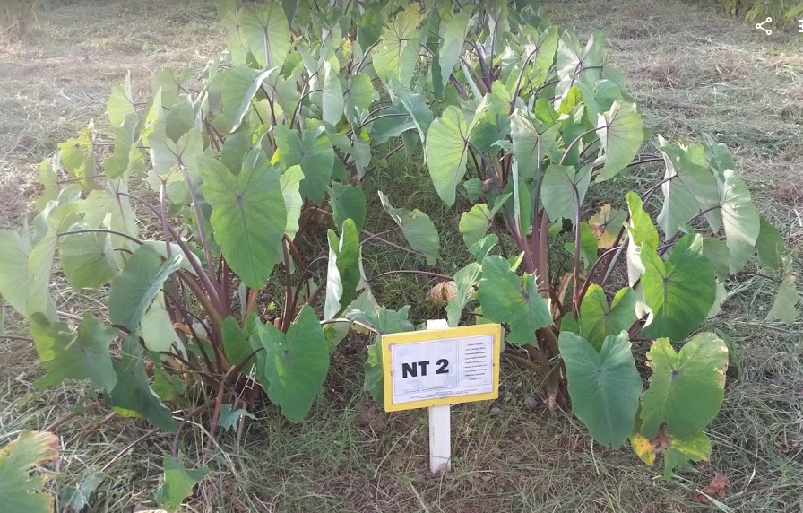
NARI Taro i swit na strong long taim bilong lip sik i stap.
Numkowec, Taro Leaf Blight i bagarapim em
Taro Leaf Blight i no inap bagarapim em –NT2

Slide 8
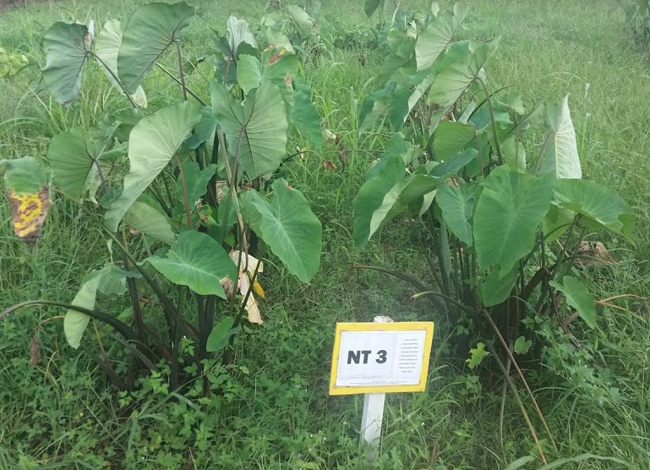
NARI Taro i swit na strong long taim bilong lip sik i stap.
Numkowec, Taro Leaf Blight i bagarapim em
Taro Leaf Blight i no inap bagarapim em –NT3

Slide 9
NARI Taro i swit na strong long taim bilong lip sik i stap.
Numkowec, Taro Leaf Blight i bagarapim em
Taro Leaf Blight i no inap bagarapim em –NT4

Slide 10
NARI Taro i swit na strong long taim bilong lip sik i stap.
Numkowec, Taro Leaf Blight i bagarapim em
Taro Leaf Blight i no inap bagarapim em (Lukim, sampela lip i kisim sik) –NT5

Slide 11
NARI Taro i swit na strong long taim bilong lip sik i stap.
Numkowec, Taro Leaf Blight i bagarapim em
Taro Leaf Blight i no inap bagarapim em –NT6

Slide 12
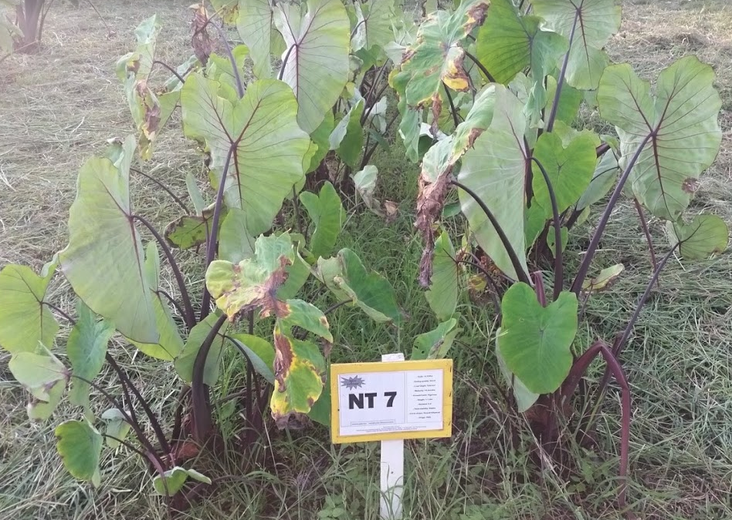
NARI Taro i swit na strong long taim bilong lip sik i stap.
Numkowec, Taro Leaf Blight i bagarapim em
Taro Leaf Blight sampela sik i bagarapim lip bilong em –NT7

Slide 13
NARI Taro i swit na strong long taim bilong lip sik i stap.
Numkowec, Taro Leaf Blight i bagarapim em
Taro Leaf Blight sampela sik i bagarapim lip bilong em –NT7

Slide 14
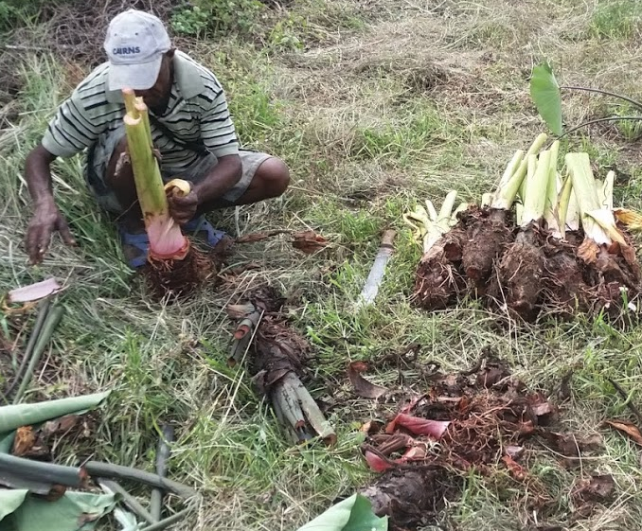
Nau tasol yumi traim dispela niupela na strongpela NARI Taro?

